Slide 1
Propositional Logic
CSI 219 – Discrete Mathematics
Instructor: Minhajul Bashir

Slide 2
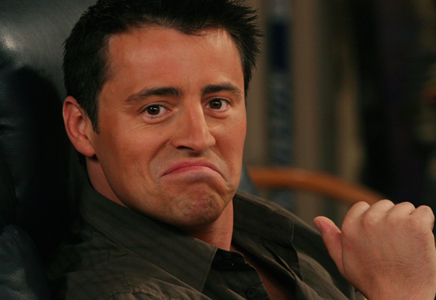
True or false?
I’m Joey Tribbiani

Slide 3
True or false?
I’m Ken Adams

Slide 4
What is a proposition?
A proposition is a declarative sentence
It can be either true or false
It cannot be neither
It cannot be both
A true proposition: He is Joey Tribbiani.
A false proposition: He is Ken Adams.

Slide 5
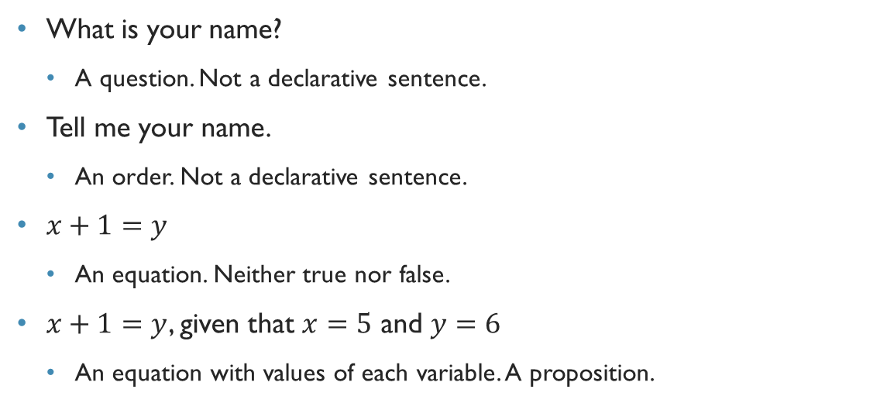
What is not a proposition?
What is your name?
A question. Not a declarative sentence.
Tell me your name.
An order. Not a declarative sentence.
$x+1=y$
An equation. Neither true nor false.
$x+1=y$, given that $x=5$ and $y=6$
An equation with values of each variable. A proposition.

Slide 6
What is not a proposition?
I am lying.
If this sentence is true, then since I am saying this, it must be false!!!
Both true and false
Not a proposition
We call such a sentence a paradox

Slide 7
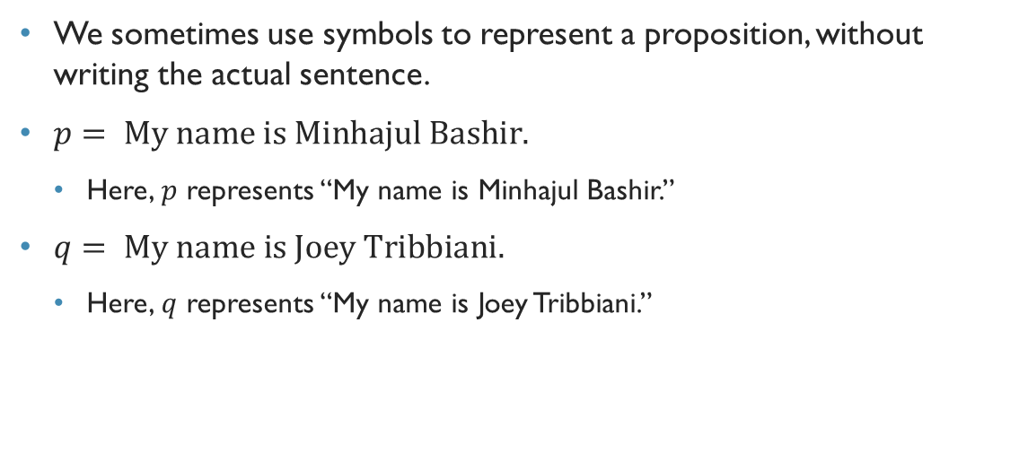
Proposition
We sometimes use symbols to represent a proposition, without writing the actual sentence.
$p= \text{My} \text{name} \text{is} \text{Minhajul} \text{Bashir}\text{.}$
Here, $p$ represents “My name is Minhajul Bashir.”
$q= \text{My} \text{name} \text{is} \text{Joey} \text{Tribbiani}\text{.}$
Here, $q$ represents “My name is Joey Tribbiani.”

Slide 8
Compound propositions
My name is Minhajul Bashir and I am a lecturer.
We can express this proposition as a combination of two propositions, along with a linker
Such linkers are – and, or, if, only if, if and only if

Slide 9
Compound propositions
My name is not Joey Tribbiani.
If we consider “My name is Joey Tribbiani” as a proposition, then the above is also a compound proposition
It only negates the actual proposition
Such a proposition is called a negation

Slide 10
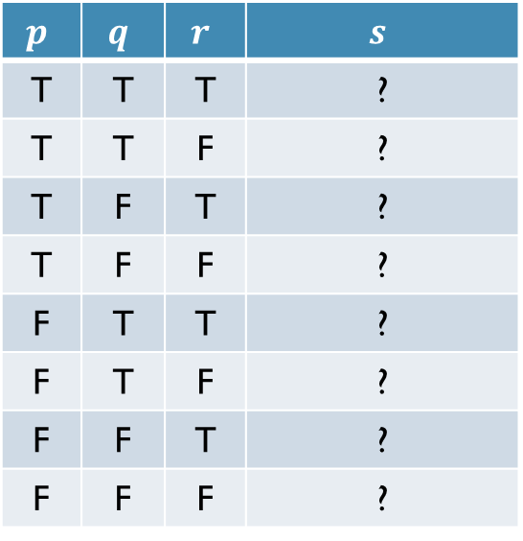
Truth tables of compound propositions
The propositions of a compound one may have different truth values
In a truth table, we consider all truth values of the propositions, and find out the truth value of the compound one
$$p$$ | $$q$$ | $$r$$ | $$s$$
T | T | T | ?
T | T | F | ?
T | F | T | ?
T | F | F | ?
F | T | T | ?
F | T | F | ?
F | F | T | ?
F | F | F | ?

Slide 11
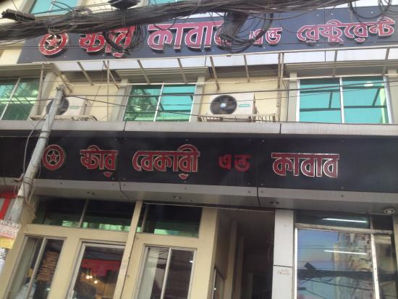
Let’s take a tour to Star Kabab!!!

Slide 12
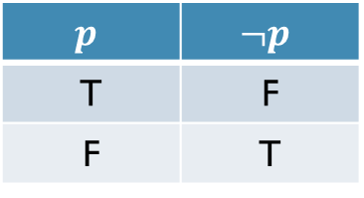

Negation
I will not eat kacchi biriyani.
$¬p$
True if the actual proposition is false.
$$p$$ | $$¬p$$
T | F
F | T

Slide 13
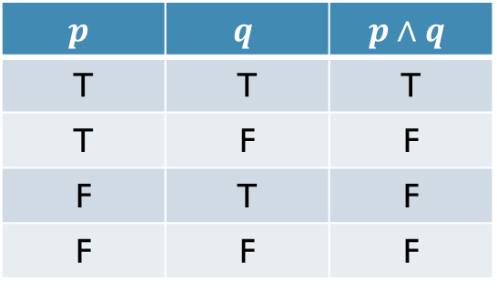
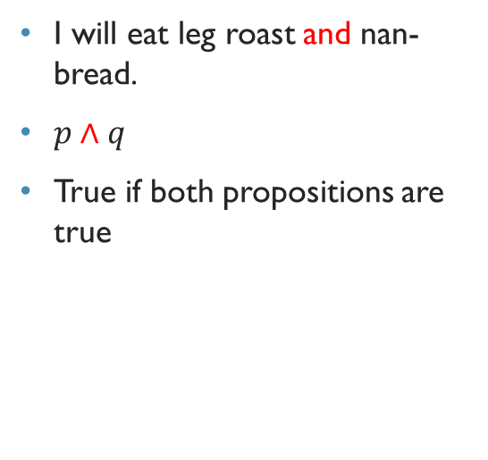
Conjunction
I will eat leg roast and nan-bread.
$p∧q$
True if both propositions are true
$$p$$ | $$q$$ | $$p∧q$$
T | T | T
T | F | F
F | T | F
F | F | F

Slide 14
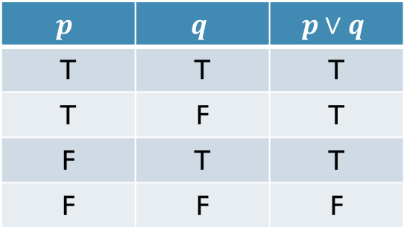

Disjunction
I will have leg-roast or murg-musallam.
$p∨q$
True if any proposition is true
$$p$$ | $$q$$ | $$p∨q$$
T | T | T
T | F | T
F | T | T
F | F | F

Slide 15
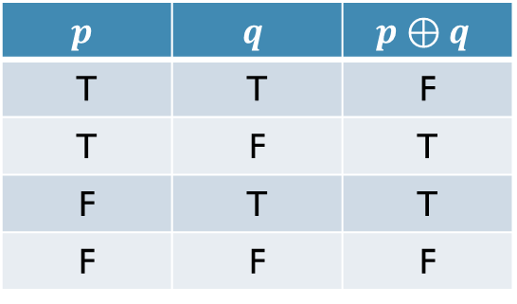
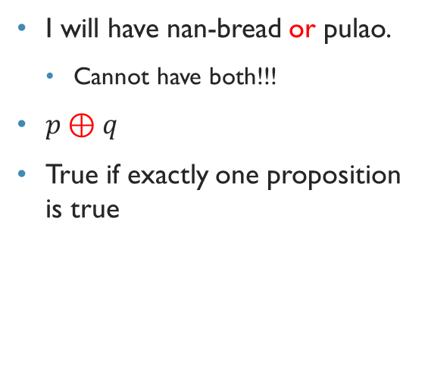
A special type of disjunction – Exclusive-or
I will have nan-bread or pulao.
Cannot have both!!!
$p⊕q$
True if exactly one proposition is true
$$p$$ | $$q$$ | $$p⊕q$$
T | T | F
T | F | T
F | T | T
F | F | F

